Slide 1
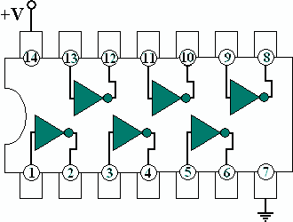
LOGIC GATES
Mrs. C. SHYAMALADEVI M.C.A., M.Phil., B .Ed.,
ASSISTANT PROFESSOR,
DEPARTMENT OF COMPUTER SCIENCE,
SHRIMATI INDIRA GANDHI COLLEGE,
TRICHY-2.

Slide 2

INTRODUCTION
Logic gates play an important role in circuit design and digital systems.
It is the basic building blocks of any digital circuit.
It is an electronic circuit having one or more than one input and only one output.
Logic gates are the switches that turn ON or OFF depending on what the user is doing!
Logic gates turn ON when a certain condition is true, and OFF when the condition is false.
– They check whether or not the information they get follows a certain rule.
Remember:
- True = ON = 1
- False = OFF = 0

Slide 3

Contd..
Gate
A Gate is a logic circuit with one output and one or more inputs; an output signal occurs only for certain combinations of input signals.
Truth Table
A Truth Table is a table that shows all the input-output possibilities of a logic circuit. Each possible input combination of bits 0 and 1 can be examined to determine the output.
Logic equation
It gives a relationship between input and output variables.

Slide 4


Slide 5
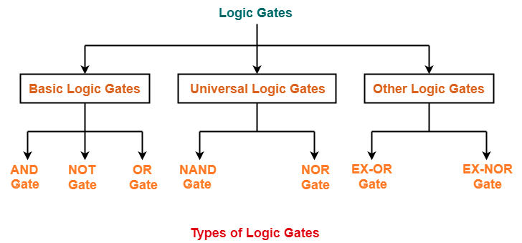
Contd..
Logic gates can be broadly classified as-

Slide 6
Basic Logic Gates
Basic Logic Gates are the fundamental logic gates using which universal logic gates and other logic gates are constructed.
There are following three basic logic gates-
AND Gate
OR Gate
NOT Gate

Slide 7
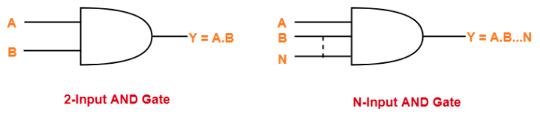
AND Gate
The AND gate produces the AND logic function, that is,
The output of AND gate is high (‘1’) if all of its inputs are high (‘1’).
The output of AND gate is low (‘0’) if any one of its inputs is low (‘0’).
The algebraic symbol of the AND function is the same as the multiplication symbol of ordinary arithmetic.
Logic Symbol-

Slide 8
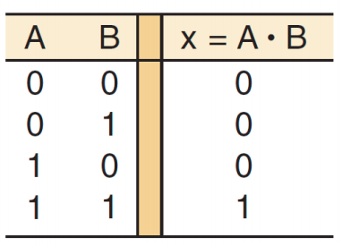
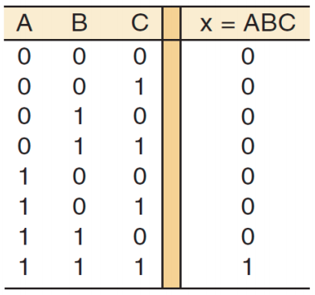
Contd..
Truth Table-
The truth table for AND Gate is as shown below-

Slide 9
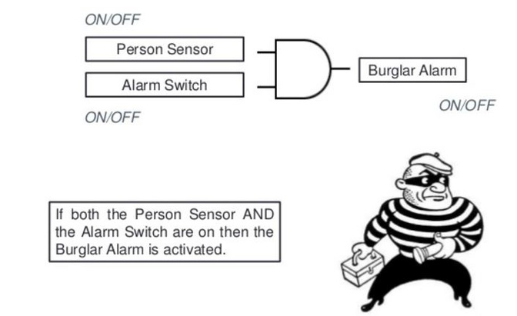
Contd..

Slide 10
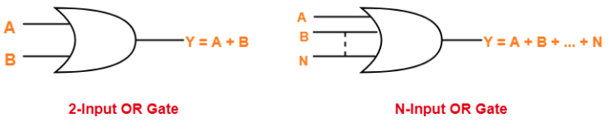
OR Gate
The OR gate produces the inclusive-OR function; that is,
The output of OR gate is high (‘1’) if any one of its inputs is high (‘1’).
The output of OR gate is low (‘0’) if all of its inputs are low (‘0’).
The algebraic symbol of the OR function is +, similar to arithmetic addition.
Logic Symbol-

Slide 11
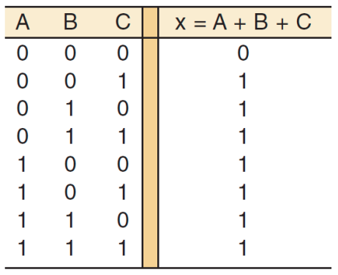
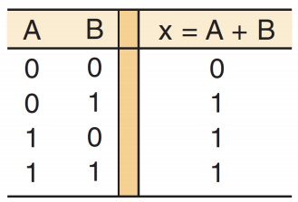
Contd..
Truth Table-
The truth table for OR Gate is as shown below-

Slide 12
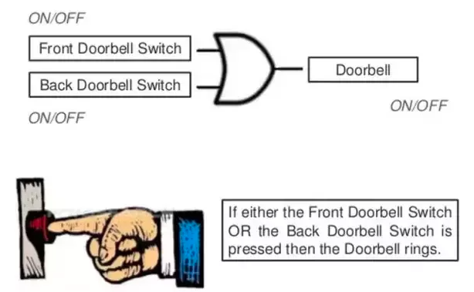
Contd..

Slide 13
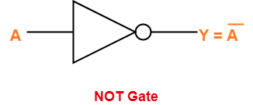
Inverter (NOT) Gate
The output of NOT gate is high (‘1’) if its input is low (‘0’).
The output of NOT gate is low (‘0’) if its input is high (‘1’).
From here-
It is clear that NOT gate simply inverts the given input.
Since NOT gate simply inverts the given input, therefore it is also known as Inverter Gate.
Logic Symbol-

Slide 14
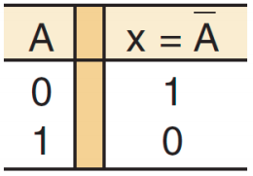
Contd..
Truth Table-
The truth table for NOT Gate is as shown below-

Slide 15
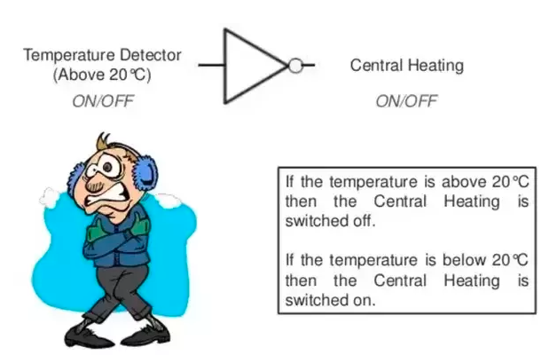
Contd..

Slide 16
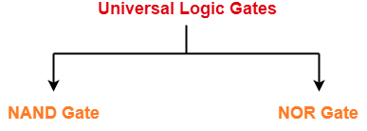
Universal Logic Gates
A universal gate is a logic gate which can implement any Boolean function without the need to use any other type of logic gate. The NOR gate and NAND gate are universal gates. This means that you can create any logical Boolean expression using only NOR gates or only NAND gates.

Slide 17
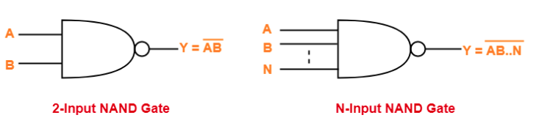
NAND Gate
A NAND Gate is constructed by connecting a NOT Gate at the output terminal of the AND Gate.
The output of NAND gate is high (‘1’) if at least one of its inputs is low (‘0’).
The output of NAND gate is low (‘0’) if all of its inputs are high (‘1’).
The designation NAND is derived from the abbreviation of NOT-AND.
Logic Symbol-

Slide 18
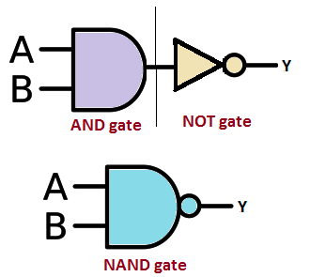
Contd..
The symbol of the NAND gate is represented as a combination of AND gate and NOT gate.

Slide 19
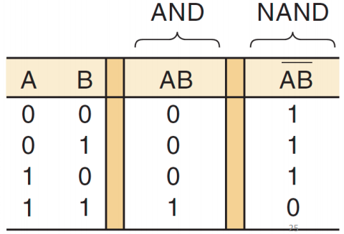
Contd..
Truth Table-
The truth table for NAND Gate is as shown below-

Slide 20
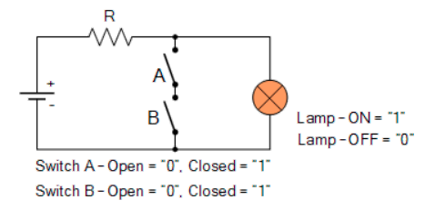
Contd..
Switch Representation of the NAND Function

Slide 21
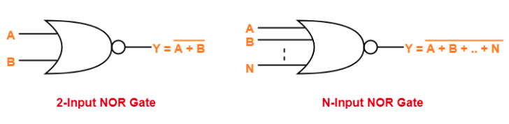
NOR Gate
A NOR Gate is constructed by connecting a NOT Gate at the output terminal of the OR Gate.
The output of NOR gate is high (‘1’) if all of its inputs are low (‘0’).
The output of NOR gate is low (‘0’) if any of its inputs is high (‘1’).
The designation NOR is derived from the abbreviation of NOT-OR.
Logic Symbol-

Slide 22
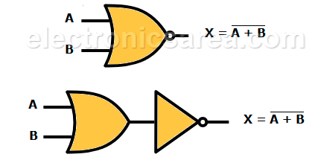
Contd..
The symbol of the NOR gate is represented as a combination of OR gate and NOT gate.

Slide 23
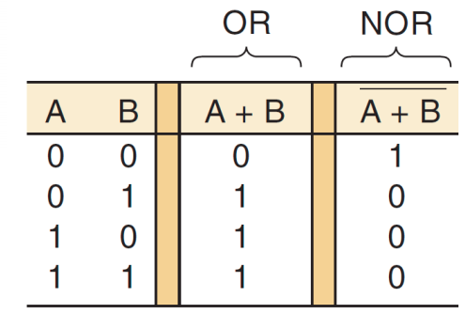
Contd..
Truth Table-
The truth table for NOR Gate is as shown below-

Slide 24
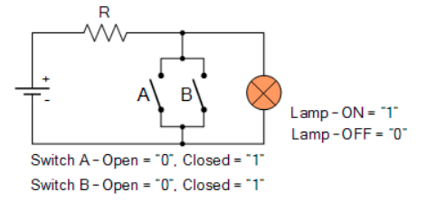
Contd..
Switch Representation of the NOR Function

Slide 25

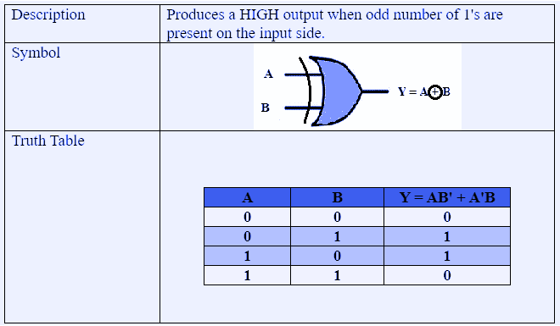
Exclusive-OR (XOR) Gate
The exclusive-OR gate has a graphic symbol similar to the OR gate except for the additional curved line on the input side.

Slide 26
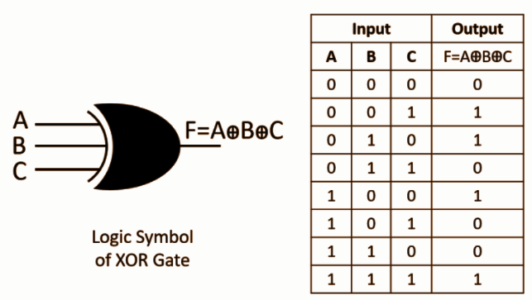
Contd..
3-input Ex-OR Gate

Slide 27

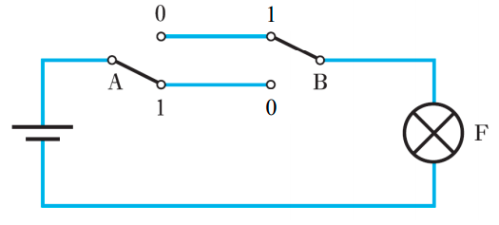
Contd..
Switch Representation of the XOR Function
The XOR operator is typically represented in an electric circuit by the two-way switching associated with a stair light.
The lamp F lights (i.e. F = 1) only when one of the switches is ON (1) AND the other is OFF (0) i.e. F = A ⊕ B =

Slide 28
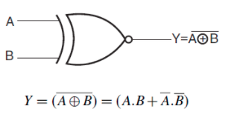
Exclusive-NOR (XNOR) Gate
The exclusive-NOR is the complement of the exclusive-OR, as indicated by the small circle in the graphic symbol.
The output of this gate is 1 only if both the inputs are equal to 1 or both inputs are equal to 0.
Logic Symbol-

Slide 29
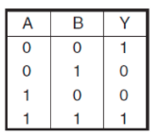
Contd..
Truth Table-
The truth table for XNOR Gate is as shown below-

Slide 30
HOW LOGIC GATES WORK - THE LEARNING CIRCUIT
https://www.youtube.com/watch?v=lXWpWNKwYbo

Slide 31


